Slide 1
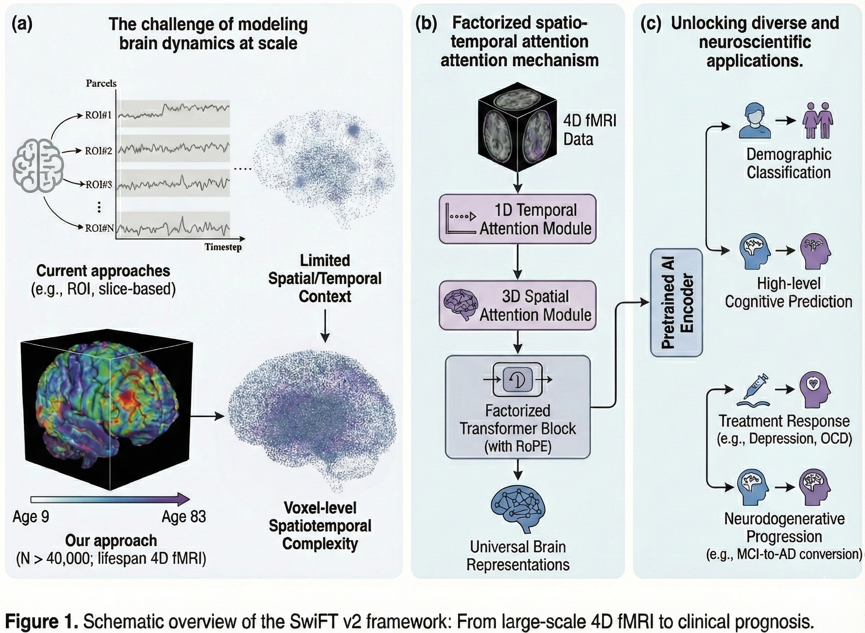

Slide 2
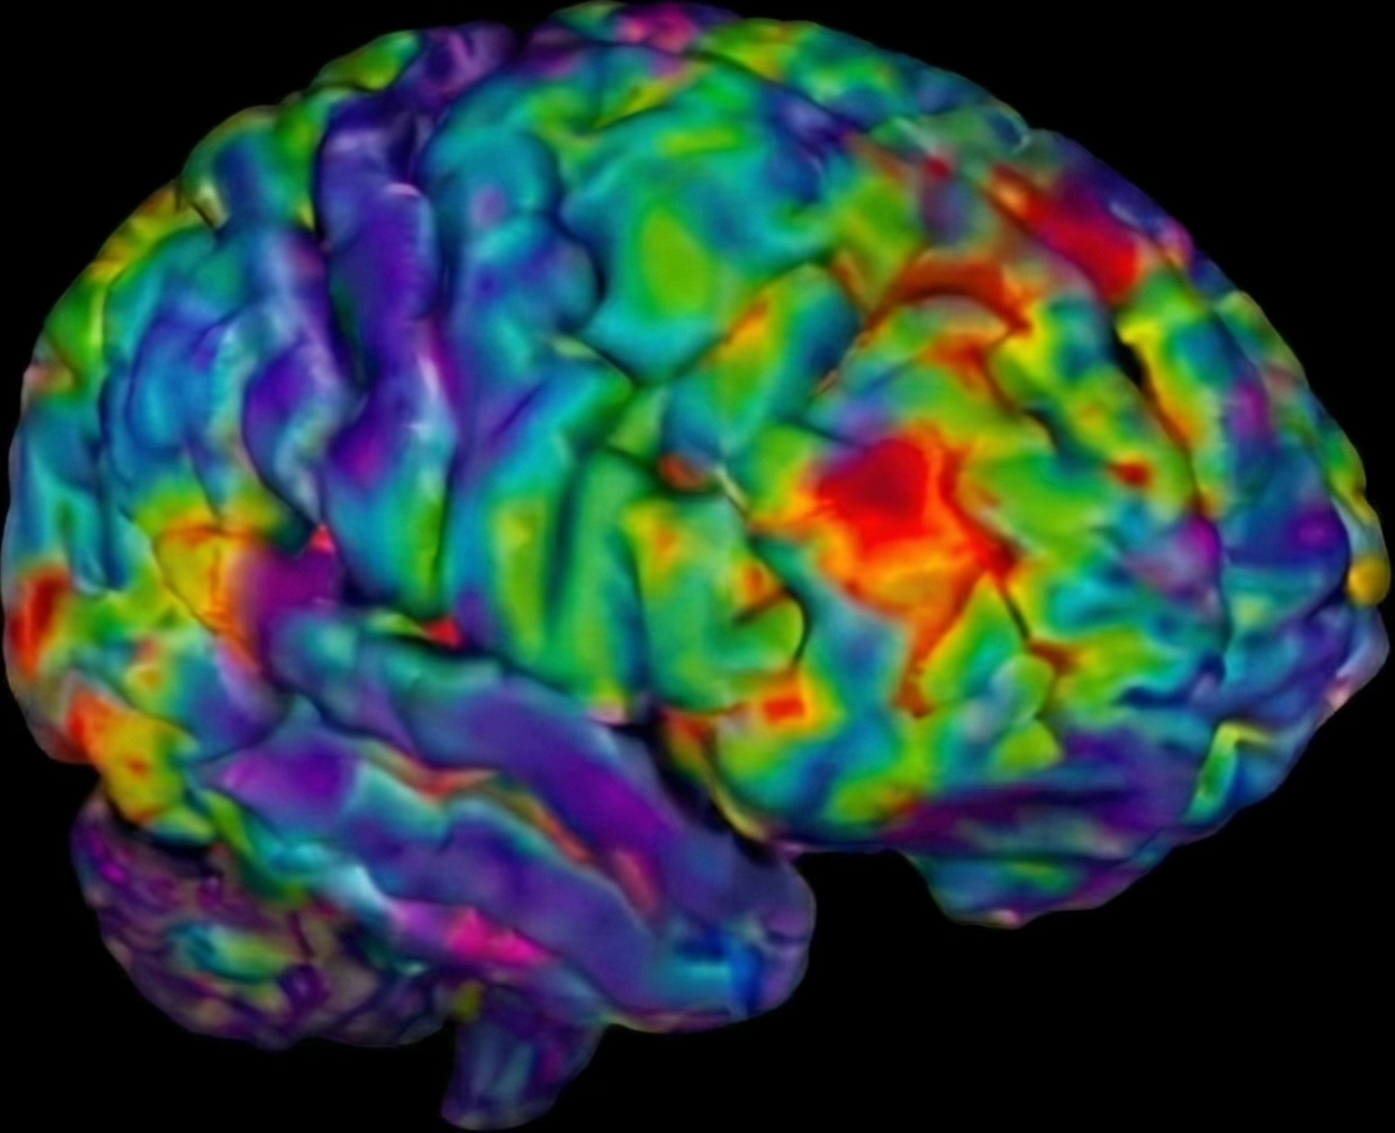

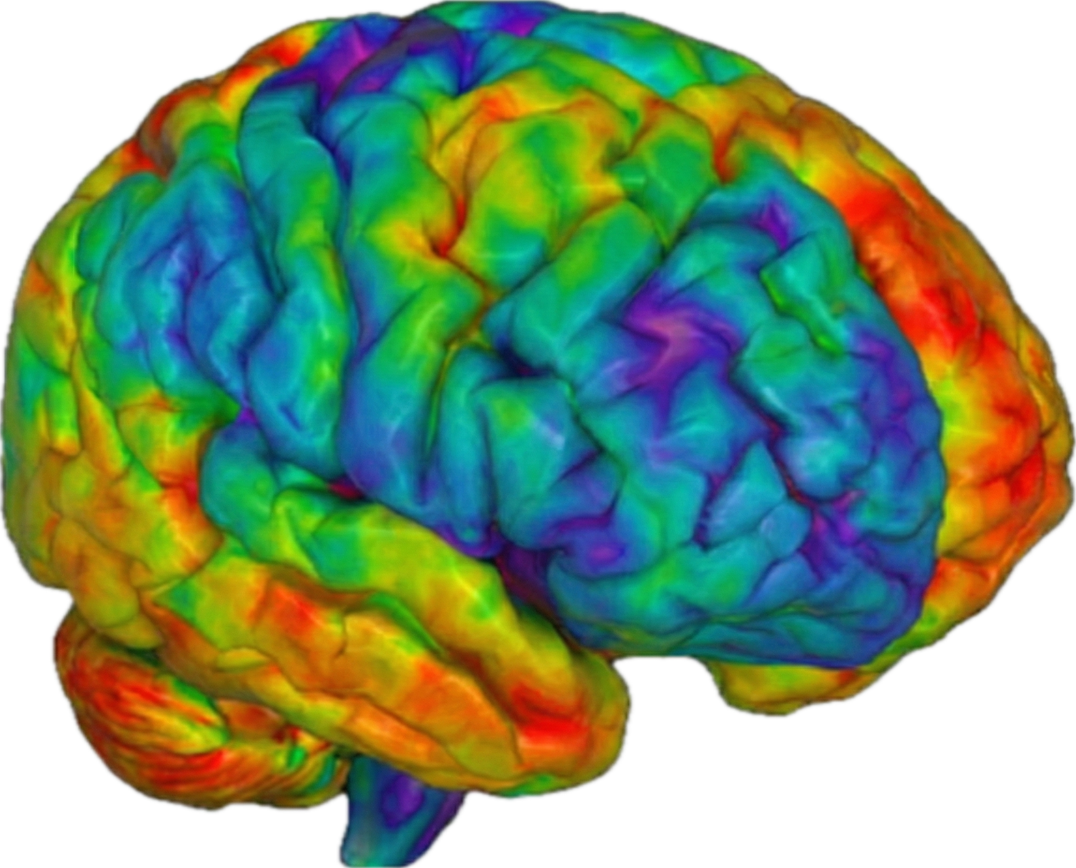
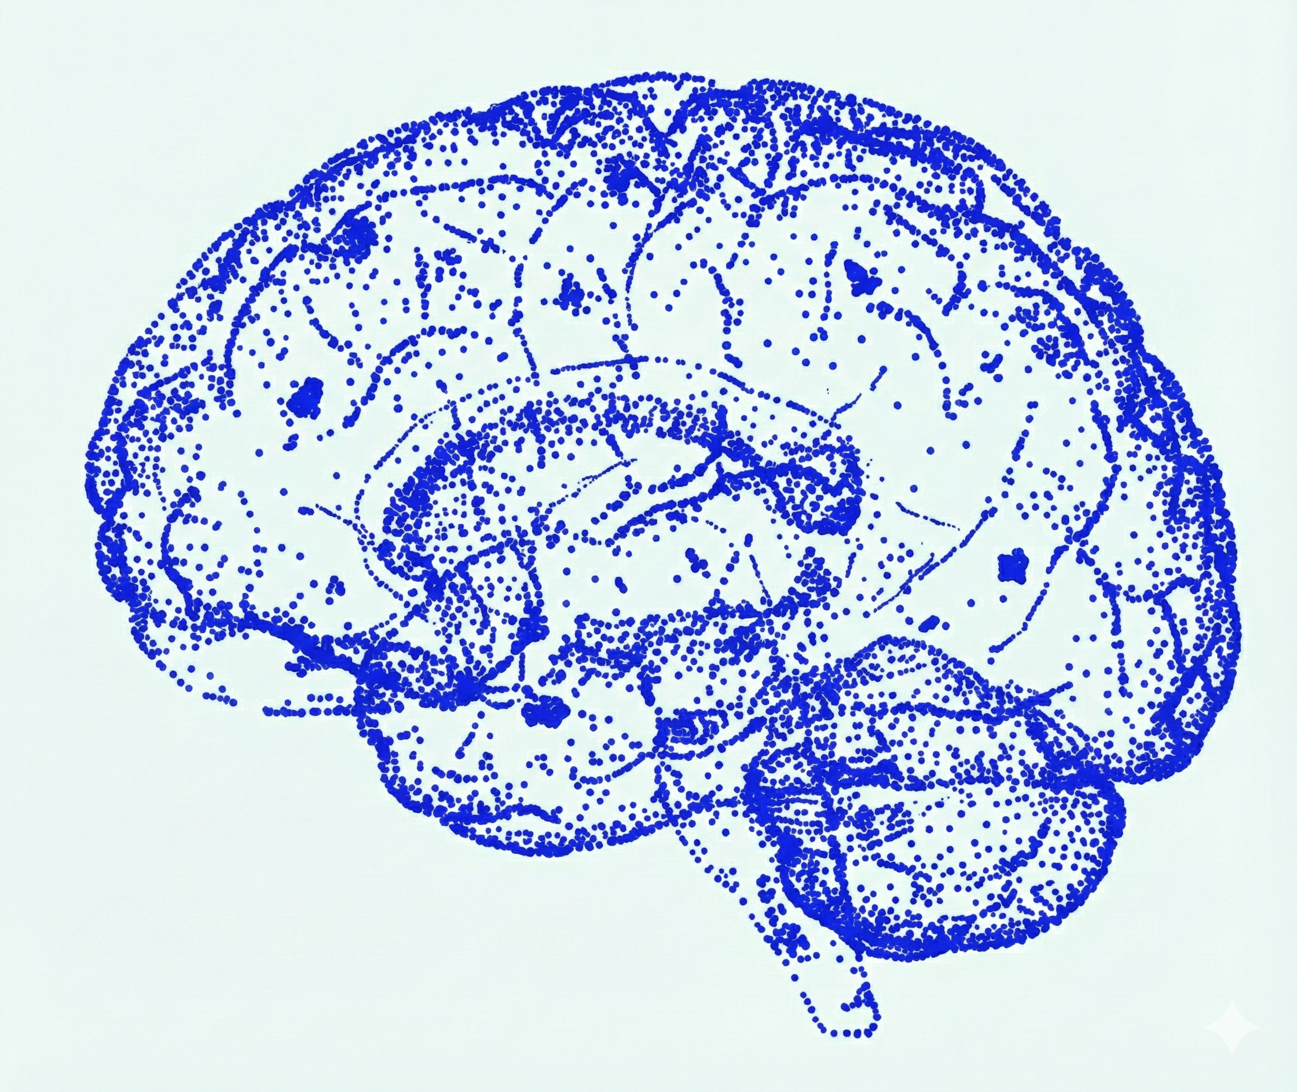
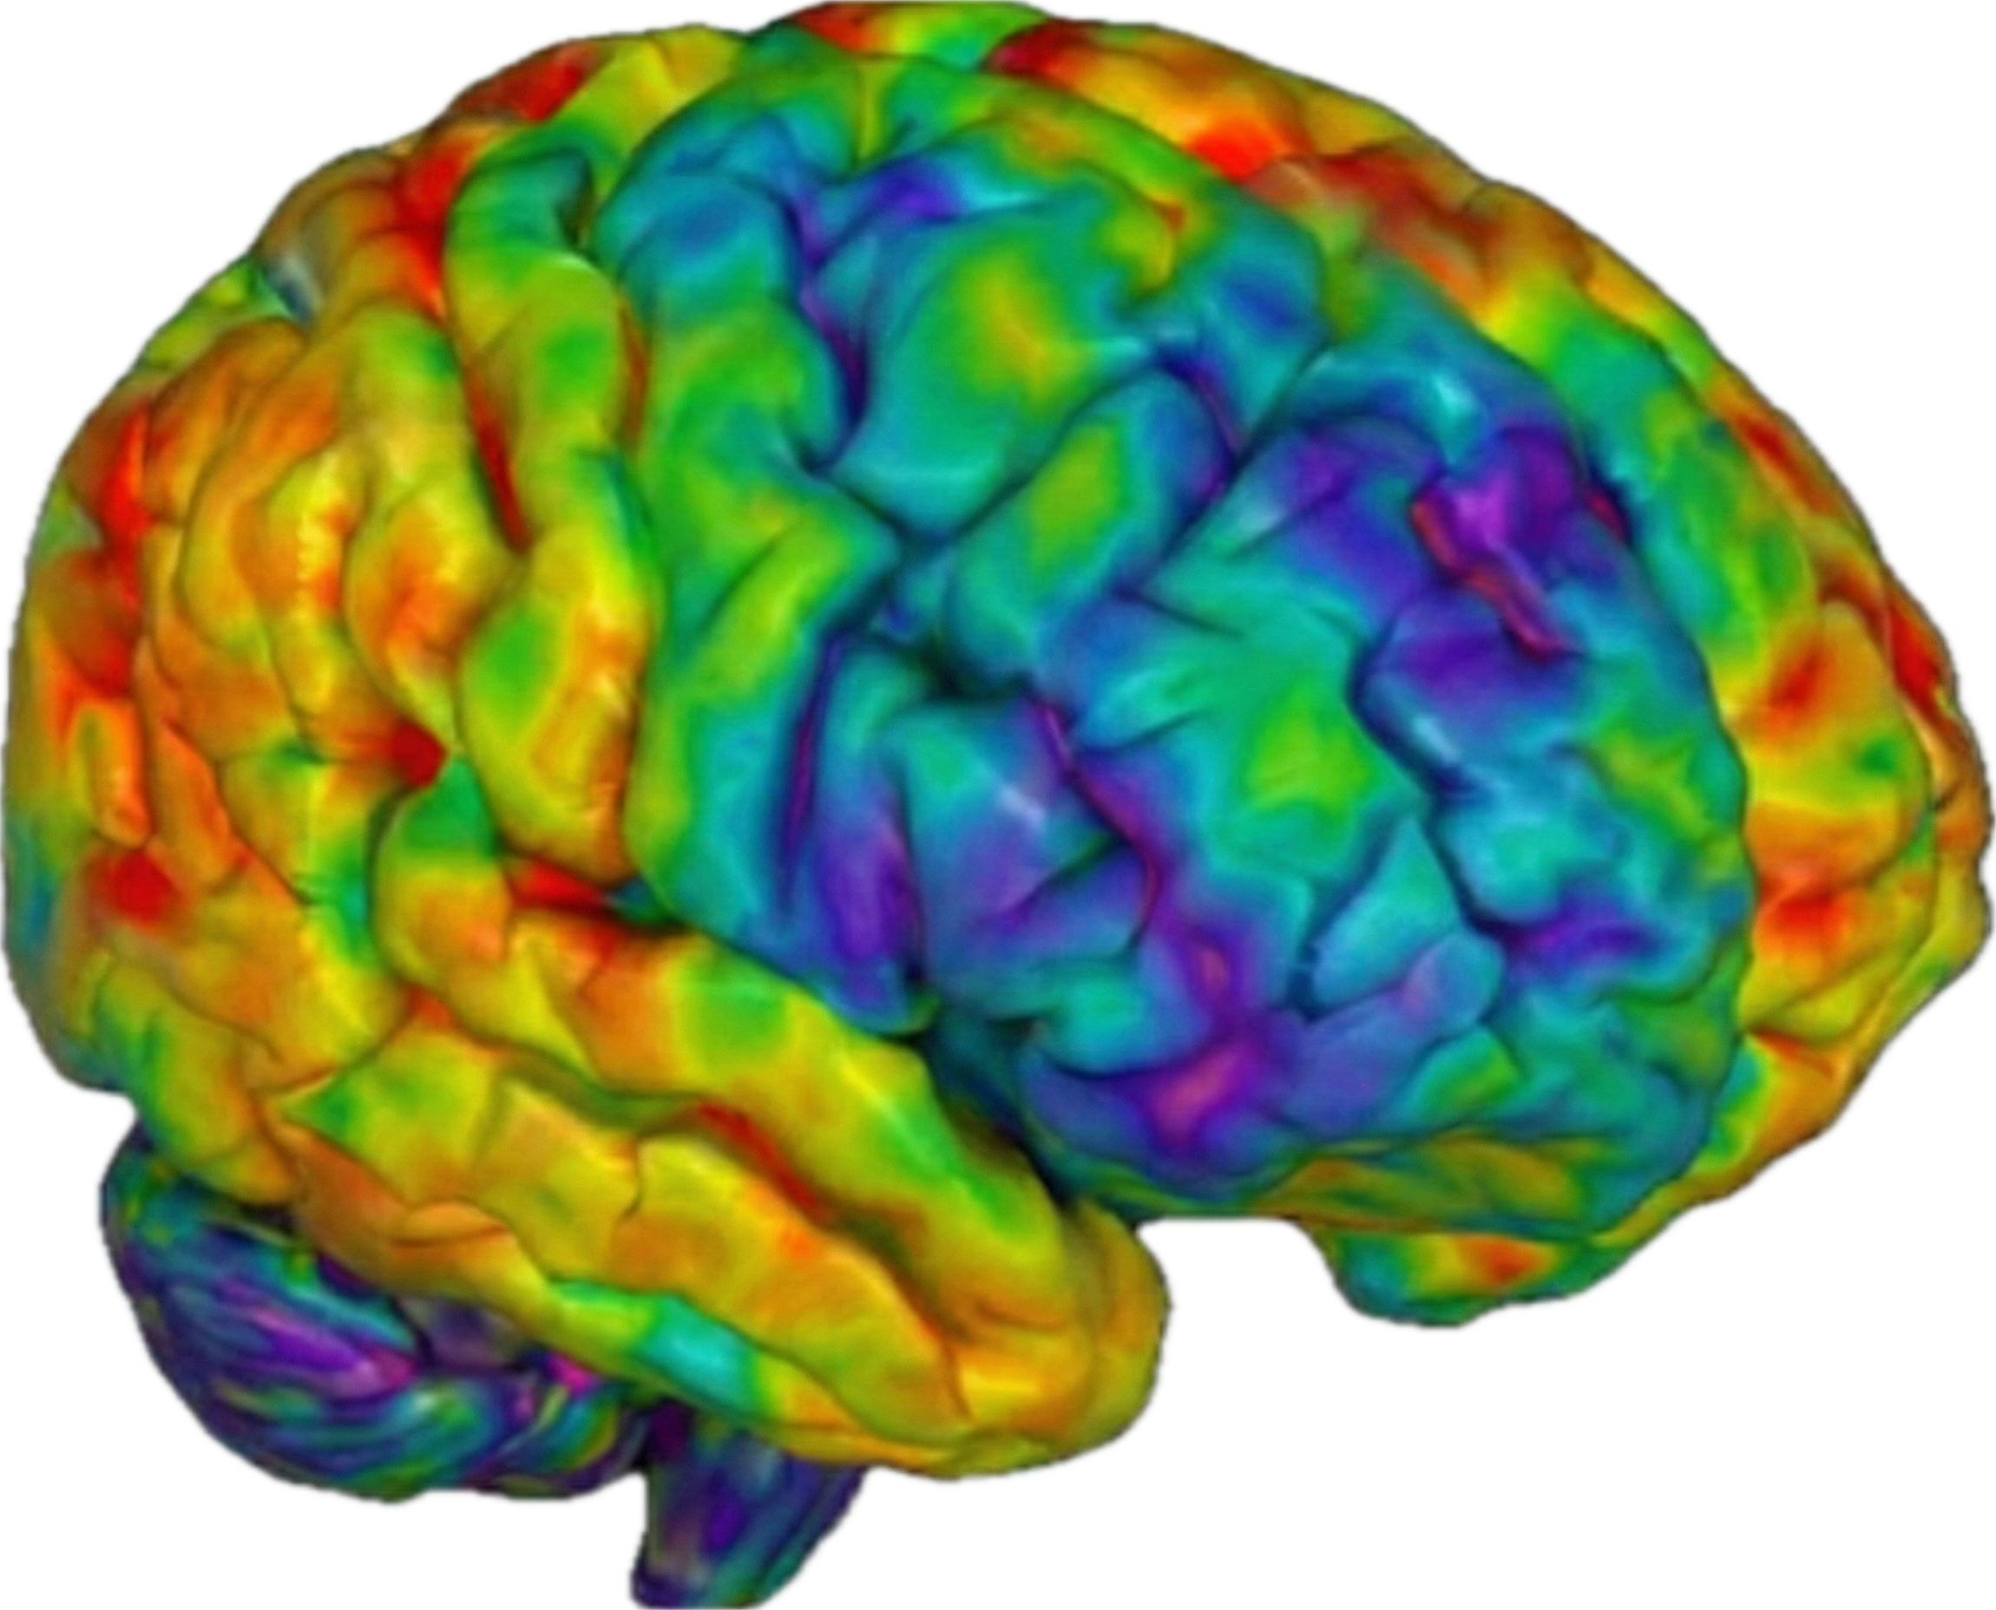
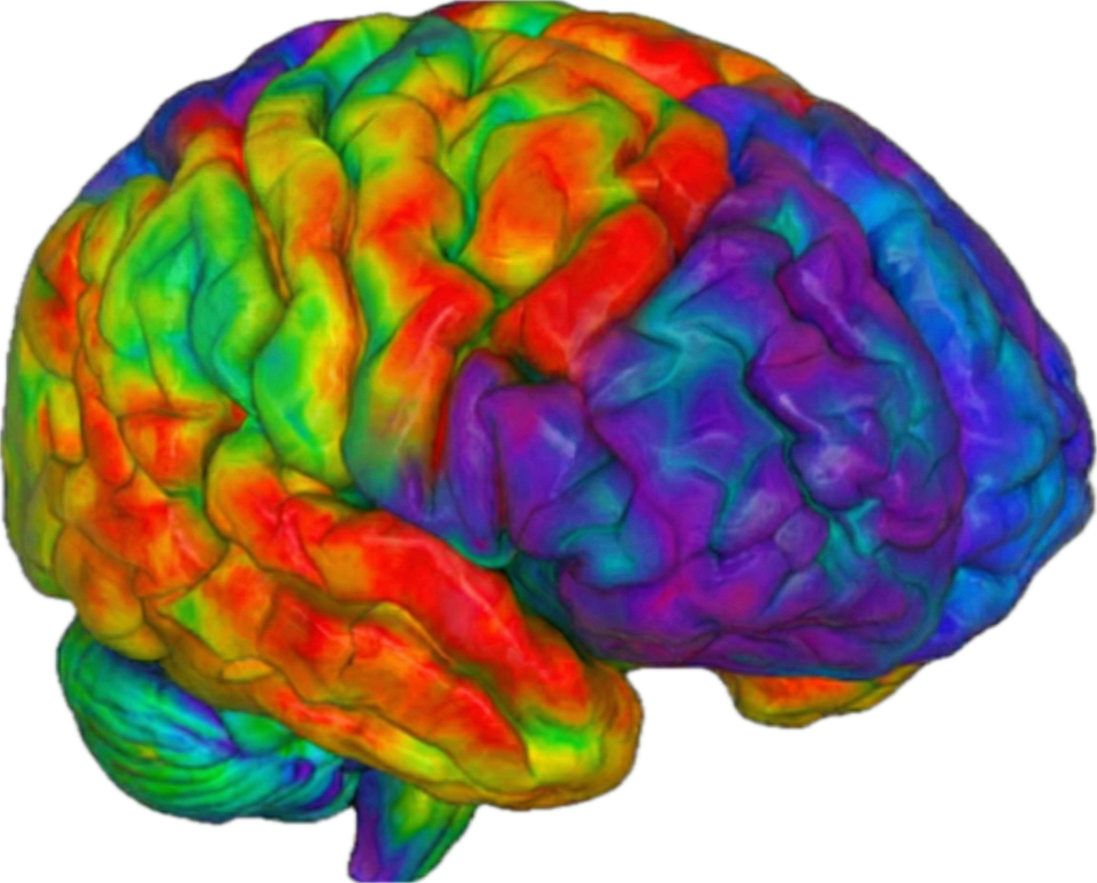


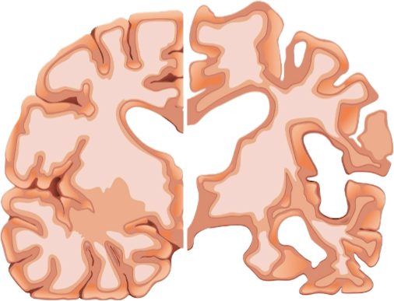


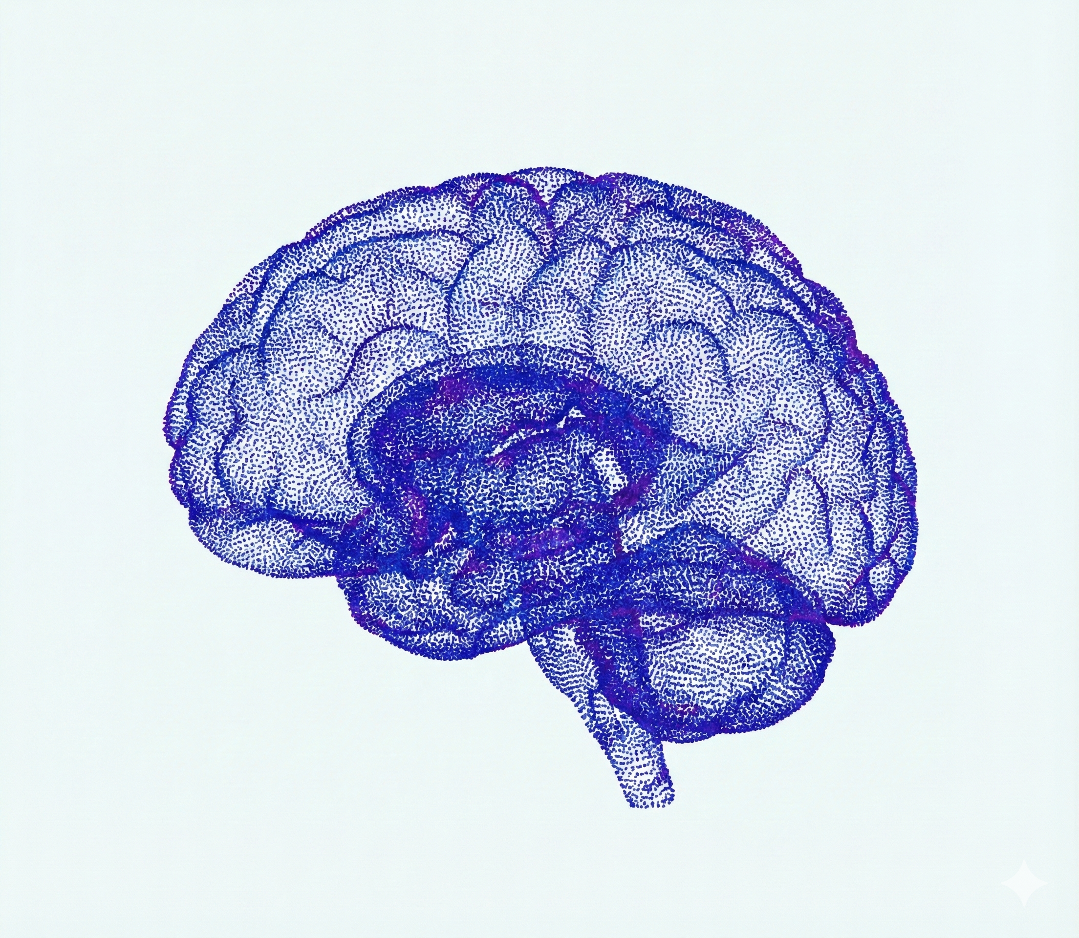



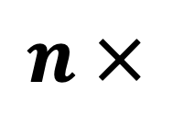
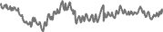
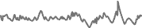
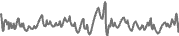
The challenge of modeling
brain dynamics at scale
Factorized spatio-temporal
Attention mechanism
Unlocking diverse
and neuroscientific applications
ROI#1
Demographic Domain
(i.e., sex and age)
ROI#2
masking
ROI#3
…
ROI#N
Time Step
Current approaches
(i.e., ROI-based)
Limited
Spatial/Temporal
Context
Neurodegenerative Domain
(i.e., MCI to AD conversion)
1D Temporal
Attention Module
Multi-Layer
Perceptron
$$n ×$$
3D Spatial
Attention Module
Psychiatric Domain
(i.e., OCD/MDD diagnosis and treatment response)
Feed-forward Layer
Transformer
Blocks
fMRI embeddings
Cognitive Domain
(i.e., intelligence, attention, and reference ability)
Time Step
reconstruction
Our approaches
(N > 50,000; lifespan 4D fMRI)
Voxel-level
Spatiotemporal
Complexity
Functional Domain
(i.e., pain-evoked states)

Slide 3
